Slide 1
March 20, 2025 | DeVos Place
Notes:
Chad

Slide 2
Introductions
Event Management – West MI Works!
Project manager, Maggie Ryan
Director of development and innovation, Chad Patton
Industry Council Leads– West MI Works!
Advanced manufacturing lead, Karrie Brown (interim)
Agribusiness lead, Carol Distel
Construction lead, Jason Khoury
Explore hospitality lead, Shakiya Taylor
Health sciences lead, Brad Sims
Information technology lead, Jules Saldivar
Intermediate Schools Districts (ISDs)
Allegan Area Educational Services Agency, Beth Johnston
Barry ISD, Rich Franklin
Ionia ISD
Kent ISD, Eric Kelliher and Ryan Graham
Montcalm Area ISD, Penny Dora
Muskegon Area ISD, Stephen Pettifor
Ottawa Area ISD, David Ladd
Employer Champions
Advanced Manufacturing
  Jake Hall, The Manufacturing Millennial
Agribusiness
  Austyn Baldasare, Hearthside Food Solutions
  Aimee Misiewicz, Herbruck’s Poultry Ranch
Construction
  Kevin Lutz, Feyen Zylstra
  John A. Hartwell, Operating Engineers Local 324
Explore Hospitality
Health Sciences
  Steven Smith, University of Michigan Health - West
Information Technology
  Eileen Boekestein, Michigan Department of Environment, Great Lakes, and Energy
  Sharon Vriend-Robinette, Corewell Health Information Technology
Notes:
Chad – thank you to all that participate, this is a community event, shout out to ISDs, WMW staff, employer champions, and ICLs. We are super excited to have agribusiness join the industries for the first in-person event.
Introduce Maggie

Slide 3

75 million workers will retire by 2030, yet only 51 million workers will enter the workforce to replace them.
The
Need
What are we doing to ensure they choose a career in Agribusiness?
Advanced Manufacturing?
Construction?
Health Sciences?
Hospitality
Information Technology?
Notes:
THE "WHY " BEHIND MICQ
75 million workers will retire by 2030, yet only 51 million workers will enter the workforce to replace them. On top of that, by 2030the bureau of labor statistics predicts an increase of nearly 12 million jobs from 2020 to 2030. So what can we do to promote our most high demand industries? One answer for our community, was MiCareerQuest.
Brief history: MiCareerQuest, an innovative, experiential career event, was created in 2015 by Michigan Works! Kent, Allegan & Barry Counties (now West Michigan Works!), Kent ISD and the Construction Workforce Development Alliance (CWDA) in response to employers’ need for future talent in construction, health care, information technology and manufacturing.
In 2016, MiCareerQuest's first affiliate event was held in Kalamazoo and today , the event has been adopted as a best practice statewide. Now, employers and industry alliances across the country are hosting CareerQuestUSA events to expose students to the wealth of career possibilities in their regions.

Slide 4
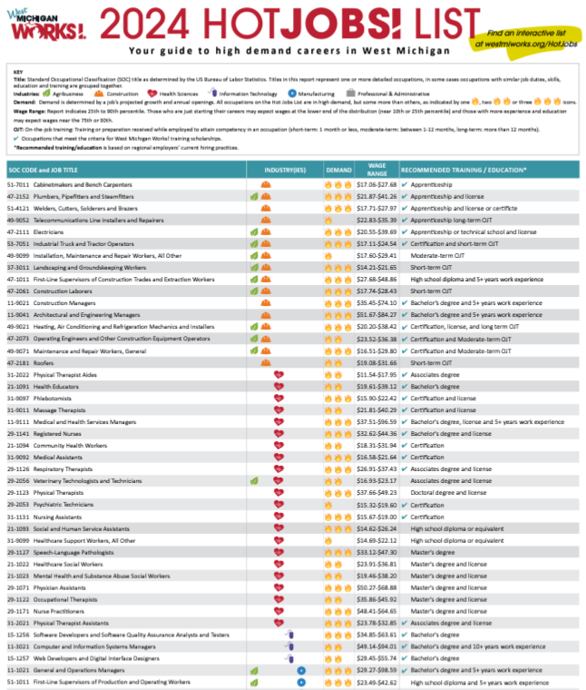





Industry Talent Councils
The data-based HotJobs! List guides which jobs are featured at the event. Signs with QR codes show the hottest jobs in our area!
Notes:
The event is backed by the 5 employer-led industry talent council, who's logo are displayed on the screen. Each council is committed to solutions to address the skilled workforce needs of West Michigan companies. A few key areas of focus for each industry are: promoting the industry, recruitment, retention, and funding for talent related initiatives.
Who They Are:
Employers, educators, workforce development experts
What They Do:
Create solutions to address the skilled workforce needs of West Michigan companies
One way that they do this:
MiCareerQuest

Slide 5
When
Event Day - Thursday, March 20, 2025
Arrive 30-45 minutes early (45 minutes recommended for Session II)
Where
DeVos Place Convention Center
303 Monroe Ave NW, Grand Rapids, MI 49503
  What
  Showcase high-demand occupations
  Interactive, hands-on, inspiring
Event Overview
Notes:
When and where
What:
MiCareerQuest is not your average career fair. In fact, it’s not a career fair at all. It’s a career exploration experience.
During MiCareerQuest, students rotate through sectors highlighting five high-demand industries: agribusiness, advanced manufacturing, construction, health sciences and information technology. Students engage directly with professionals and participate in activities that showcase various high-growth occupations, opening their eyes to opportunities for great careers in West Michigan.
Additionally, representatives from educational institutions help students make the connection between training, education and careers.

Slide 6
DeVos hall will be divided into four industry quadrants.
Industry champions will have interactive, engaging, and motivating exhibits showcasing the career opportunities within their industry.
Higher Education Sponsors will be strategically placed throughout DeVos hall to maximize exposure to students.
Quadrants will be piped and draped in a color matching initial lanyard entrance color, with an entrance and an exit to facilitate student movement.
The Layout
Notes:
Session Times Notes:
Student Flow Notes:
Post Event Notes:

Slide 7
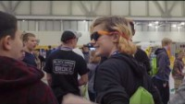
What is MiCareerQuest?
…and agribusiness/hospitality!
Notes:
Employers participating in their first MiCQ event, often stat they wish they was a better way to prepare employers for what they would experience. This video showcases activities from a previous event
We would like play that for you now.

Slide 8
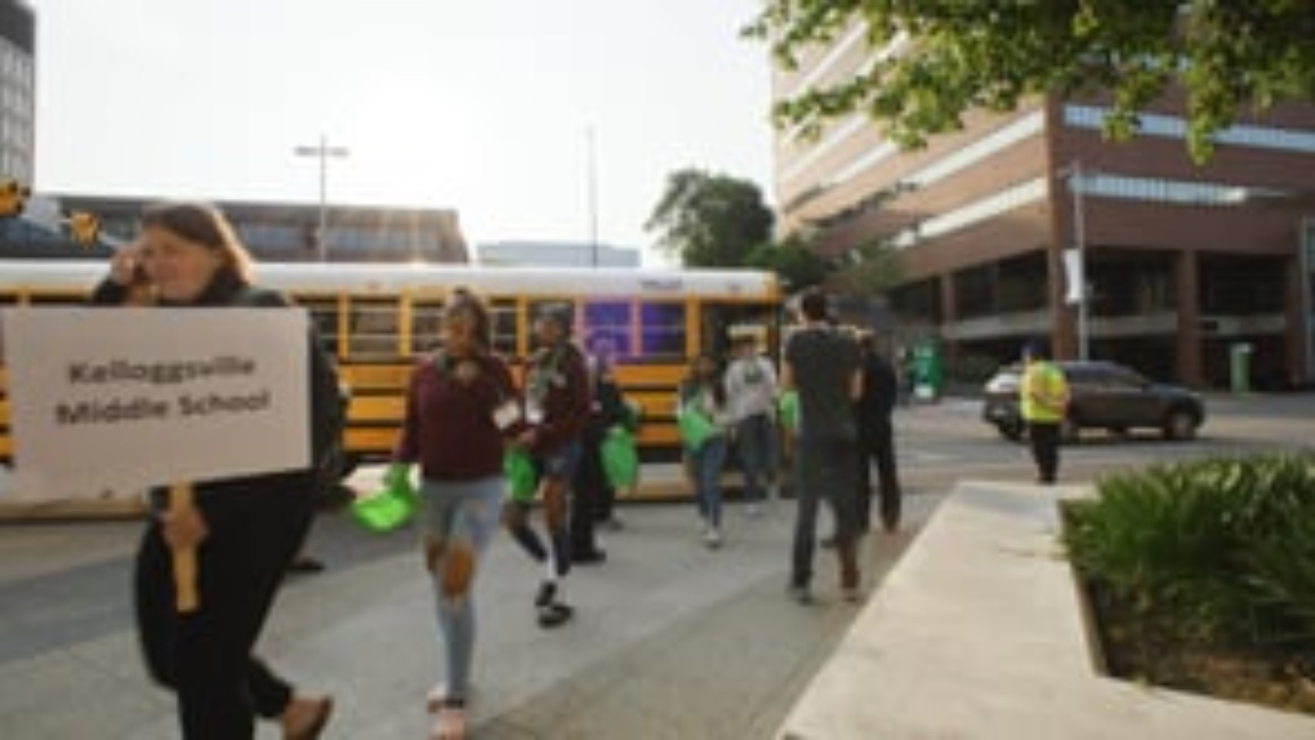
Video: MiCareerQuest Student Journey

Slide 9
    8790 students registered.
    111 companies represented.
    293 jobs represented.
2025 Highlights
“I love how interactive it was. The people there were amazing and explained everything you need to know in detail. The set up was the best part though, Its like you were actually on the job. This career quest made me feel special, like it made me feel like I could do anything.”– 2024 Student Participant
    “The students enjoyed how interactive everything was. It is one thing to hear about an industry, but it's an entirely different experience when you get to try the actual work in that industry.” – 2024 Educator

Slide 10
Student media (in school newspapers, video reporting programs) are invited to attend using press passes.
Reach out to mryan@westmiworks.org with teacher or student media contact.
Photographs and videos will be taken and may be used in promotional materials regarding MiCareerQuest without a release. Please ensure all students attending are able to have their pictures and videos taken at this large, public event.
Video interviews: we will seek parent/guardian release of student interviews taken for promotional purposes. Reporters may have different policies.
Anonymized survey responses will be used
Photos/
Media

Slide 11
Prepare students for the employers at the event (Educator Packet) and jobs represented by industry (Educator Packet).
Review Educator Packet: Student activities, with post-event activity! Very important to do before MiCQ – helps prepare students!
Questions for exhibitors – Most important
Online resources available with additional activities (mynextmove.org)
Pre-Event Activities

Slide 12
3D 2024 Walkthrough on micareerquest.org instructions
Link to 2024 3D Walkthrough page
2025 Maps
Videos: For educators/Parents
Pre-Event Activities

Slide 13
On the bus to MiCareerQuest:
Review potential questions to ask employers at the event.
Review expectations for students at event. There are many activities, so students do not generally move as a single class.
Review exit plans: students leave DeVos and then go left then right at the bridge to cross the Grand River.
Remember to bring lanyards and inserts!
Extra available at info desk
Pre-Event Activities

Slide 14
Arrival

Slide 15
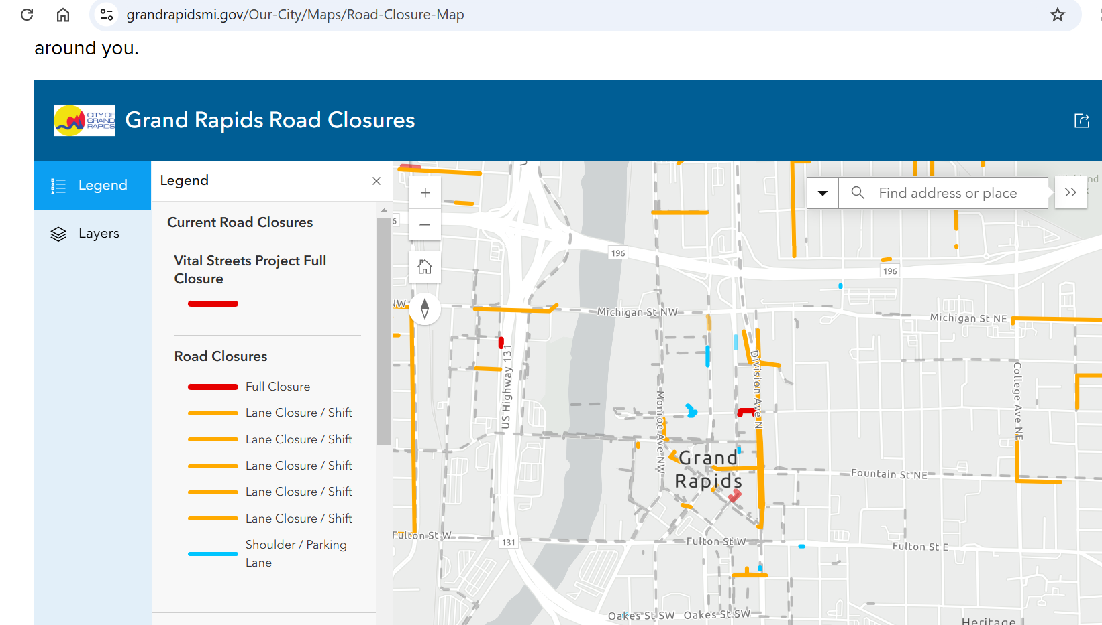
Division Ave. will be closed from Fulton St. to Michigan Ave. from March-November.
Lyon St. NW will be closed (impacts DeVos parking lot entrances)
Road Closures

Slide 16
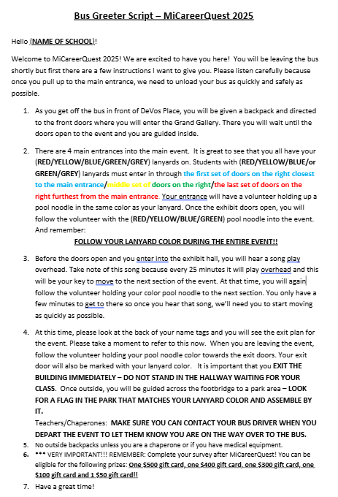
Arrival: Greeting

Slide 17
Every student and chaperone should have lanyard
Chaperone will complete survey questions on mobile phone using QR code
Arrive to DeVos Place and in exchange for information about number of students, you will receive:
1. School sign to gather after MiCareerQuest with
2. Surveys to give to students on bus ride home
3. MiCareerQuest backpacks for all students
No outside backpacks allowed: One chaperone should bring a backpack to hold their sign during MiCareerQuest. Medical devices and medical products are allowed, but all bags, including chaperone bag, subject to inspection.
Arrival

Slide 18
Bus Parking
Get bus driver’s phone number to
reconnect after event

Slide 19
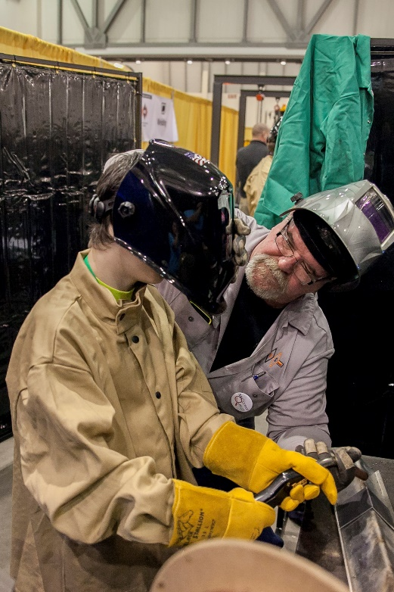
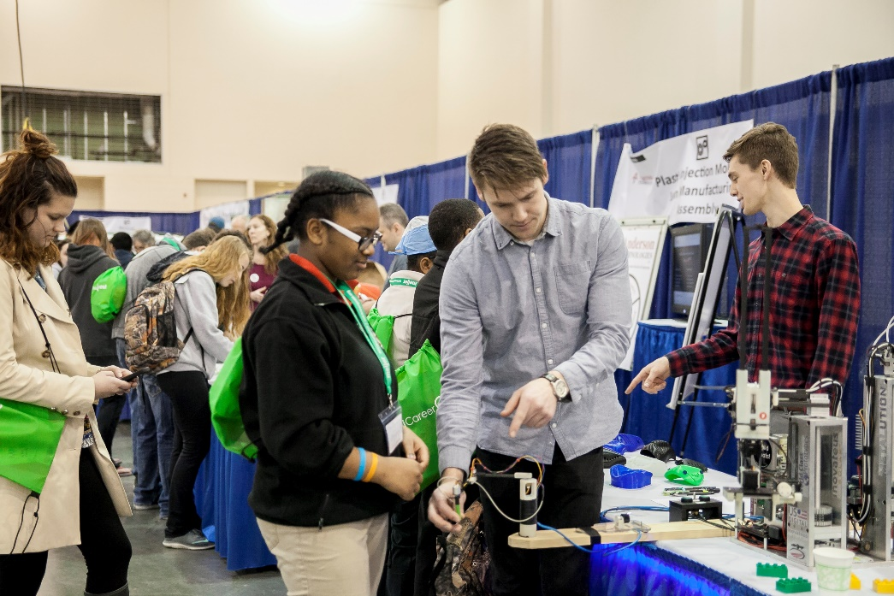
Students come in from one of three sessions:
    8:30 am – 10:15 am
    10:15 am – noon
  noon – 1:45 pm
  Students start in one of the exhibit spaces and move throughout the hall to experience all six industries.
Student Experience

Slide 20
Students will arrive via the Monroe entrance and will wait in the Grand Gallery until their assigned start time.
23 minutes in each industry sector.
Music marks when students will need to switch quadrants. Follow their color pool noodles.
If you need to leave early, reach out to Maggie at mryan@westmiworks.org or notify the overhead announcer stationed near the concession stand if day of event
Student Experience

Slide 21
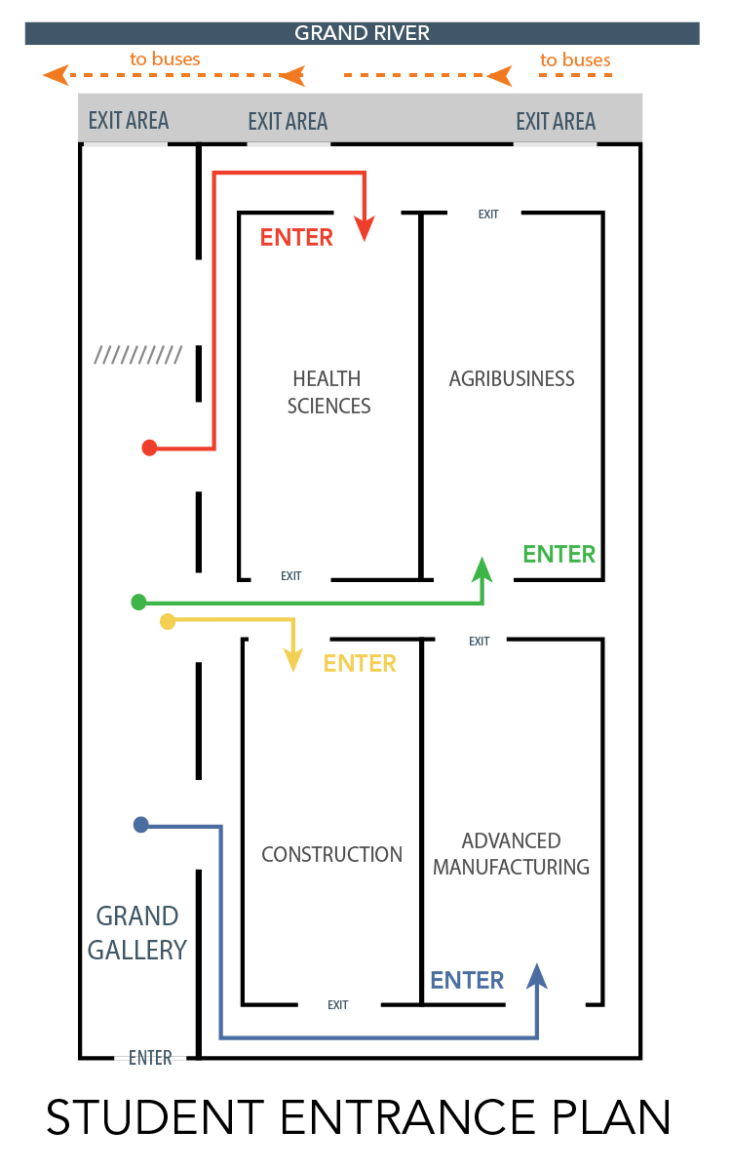
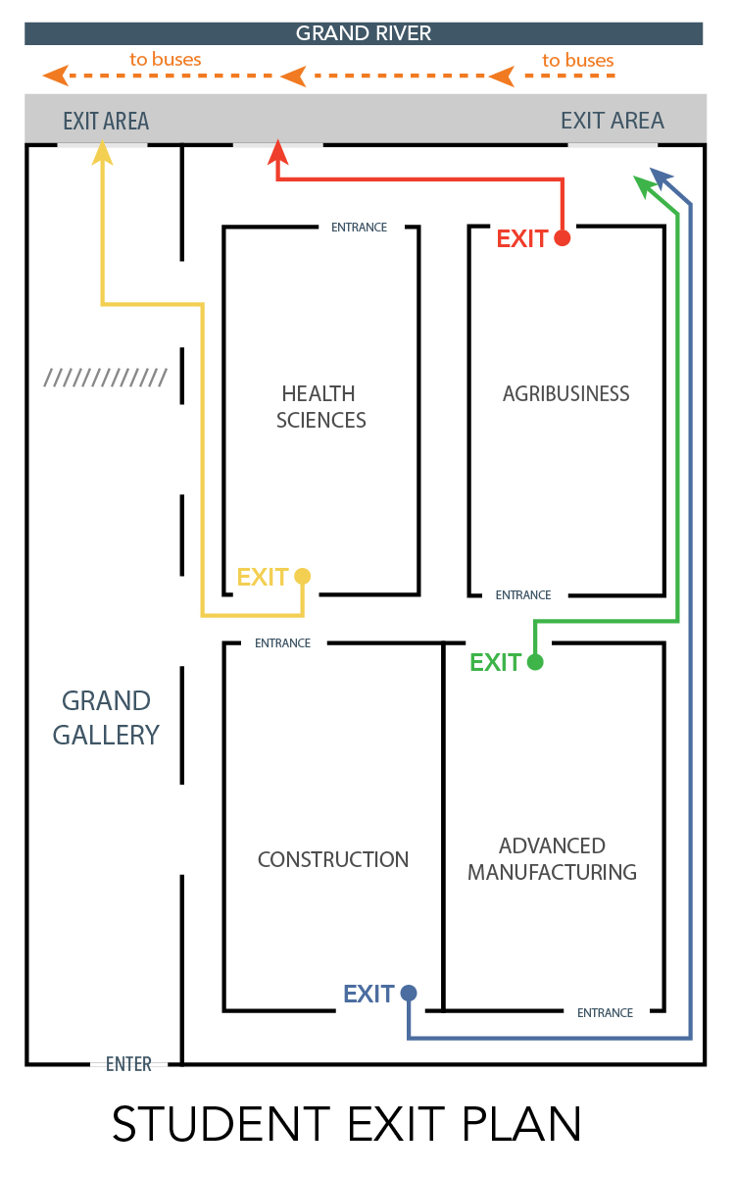

Student Flow
Bus Drop Off
Notes:
Students start in Grand Gallery, and have been assigned by lanyard color to start in a quadrant, then flow through counterclockwise. They have about 23 minutes per quadrant, with time for moving between rooms. After students have completed a full rotation, they exit to the busses, and the next Session of students immediate.
This is a concept map that includes Agrbusiness but as mentioned earlier, this is simply a concept as the final layout has not yet been confirmed.
Session Times Notes:
Student Flow Notes:
Post Event Notes:

Slide 22
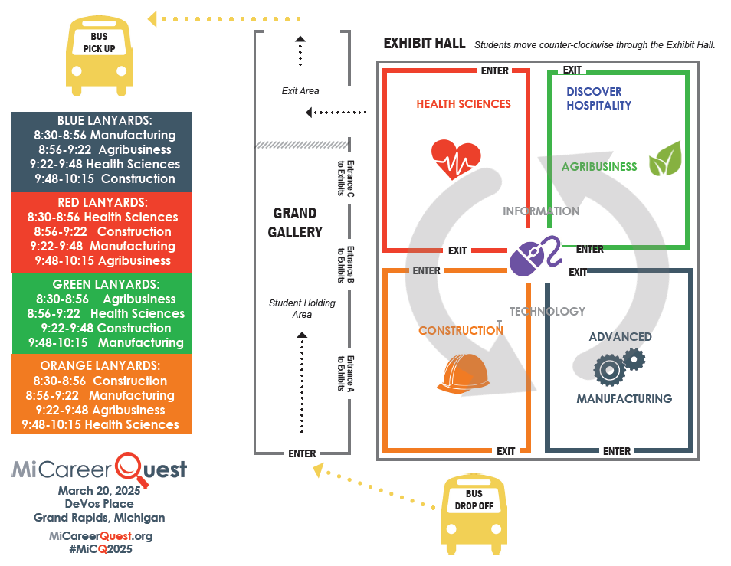
Student Flow

Slide 23
EXIT PLANS
Color papers will show doors to exit from
Carpool/chaperone-driven students: Exit same way. After DeVos Place building, break left to go to parking lot (bus driven students will go right to go over Grand River)
Exit Plan on
every student lanyard
Notes:
Review CJ Student Position Descriptions for Grand Gallery Flow (Mark) and Exhibit Hall (Craig)

Slide 24
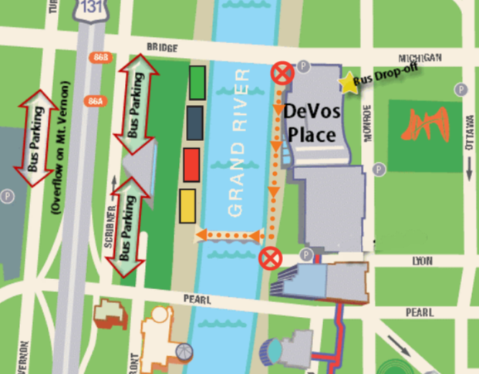
Exterior Exit Plan
Use your school sign to meet your
students here, arranged by lanyard colors. USE BUDDY SYSTEM.
Breakaway for chaperone-
driven students
Wear weather appropriate clothing.
Will take 15-20 minutes to gather after session ending.

Slide 25
Students receive survey link via QR code. Have them fill this out on bus ride back. DO NOT GIVE OUT BEFORE.
Educator survey available on micareerquest.org – SCECH credit available
Prizes available for survey responses for educators and students
Bus ride home

Slide 26
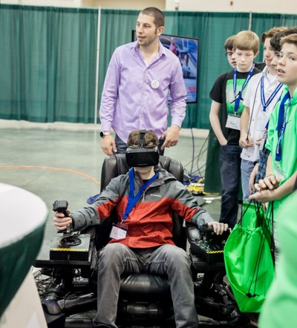
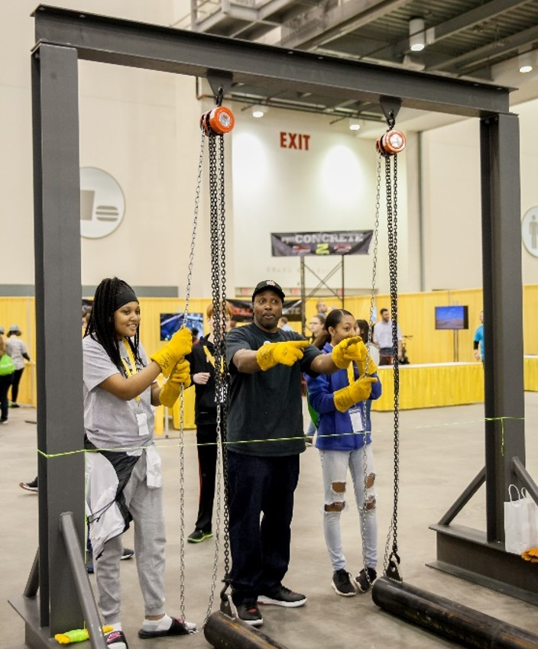
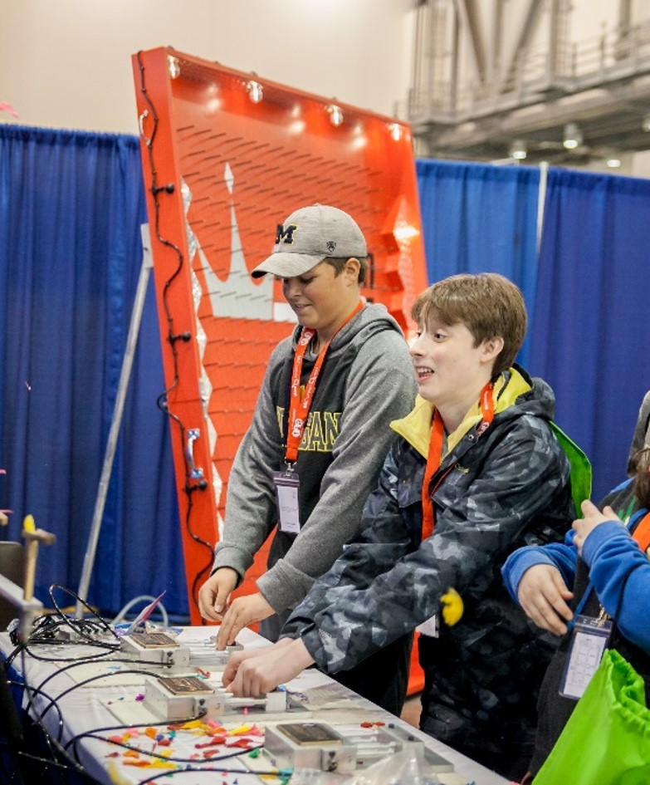
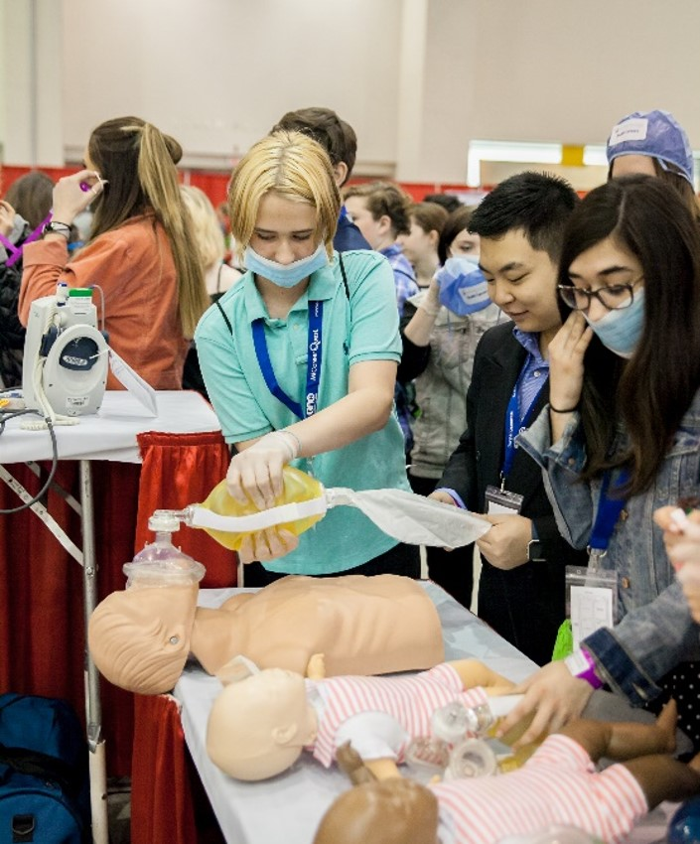
Exhibit Examples
Exhibit Sample

Slide 27
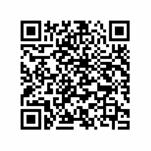
Survey for SCECH credits

Slide 28
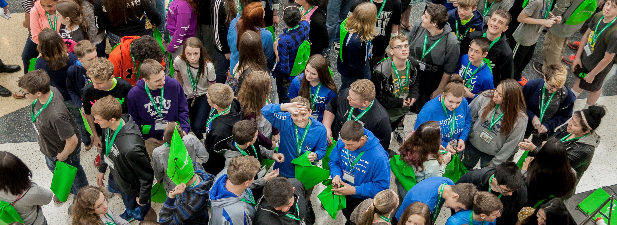
THANK YOU!
THANK YOU!
Notes:
We’d like to end our presentation the same way we started: with a big THANK YOU!!

Slide 29
Questions?

